Slide 1
Types of Business Intelligence Tools and Applications
Ad hoc analysis
Online Analytical processing
Mobile BI
Real time BI
Operation Intelligence
Open-Source BI
Embedded BI
Collaborative BI
Location Intelligence
Business intelligence vendors and market
Sehrish Aqeel
www.aisciences.io

Slide 2

Online Analytical Processing
OLAP (Online Analytical Processing) is the technology behind many Business Intelligence (BI) applications.
OLAP is a powerful technology for data discovery, including capabilities for limitless report viewing, complex analytical calculations, and predictive “what if” scenario (budget, forecast) planning.

Slide 3
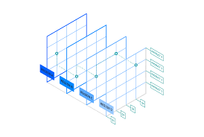
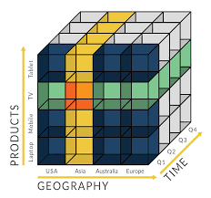
Online Analytical Processing
It is a category of software technology that enables analysts, managers and executives to gain insight into data through fast, consistent interactive access to a wide variety of possible views of information that has been transformed from raw data to real dimensionality of the enterprise.

